Slide 1
CONNECTTEL CUSTOMER CHURN PREDICTION PROJECT
David O. Nduka(PhD)
RELLNATrends

Slide 2
PROJECT FOCUS
Problem definition
Exploratory data analysis in Python
Feature engineering
Model selection, training, and validation
Model evaluation
Recommendations
Conclusion

Slide 3
Problem definition
ConnectTel, a leading telecommunications company at the forefront of innovation and connectivity solutions engaged RELLNATrends on their pressing need to address customer churn, which poses a significant threat to its business sustainability and growth.

Slide 4
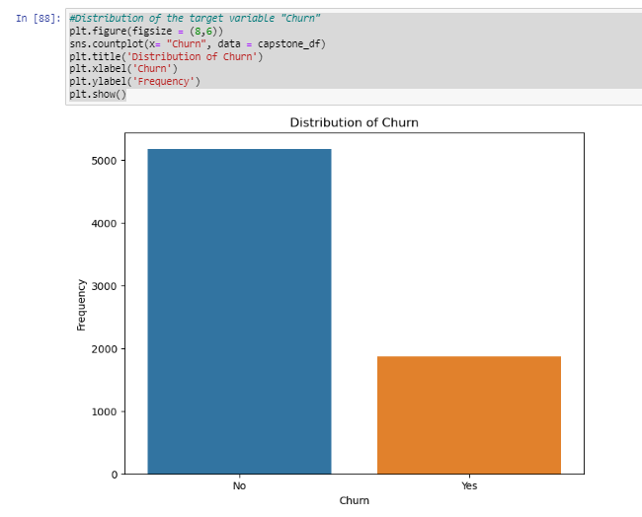
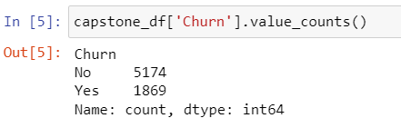
Exploratory data analysis: Univariate

Slide 5
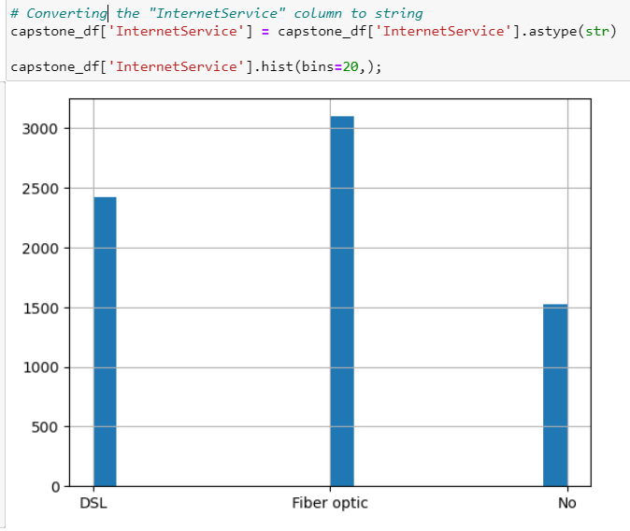
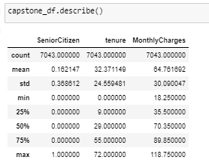
Exploratory data analysis: Univariate Cont.

Slide 6
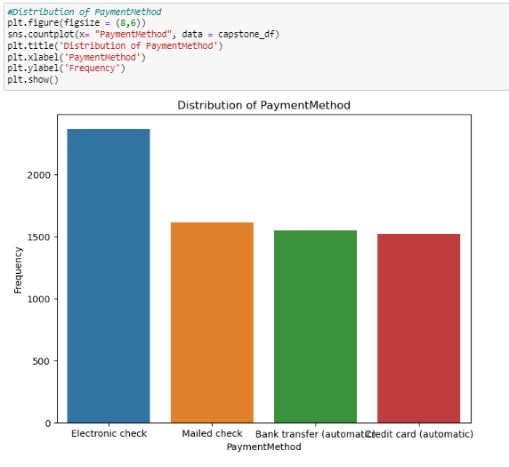
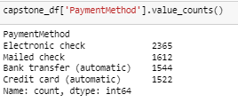
Exploratory data analysis: Univariate Cont.

Slide 7
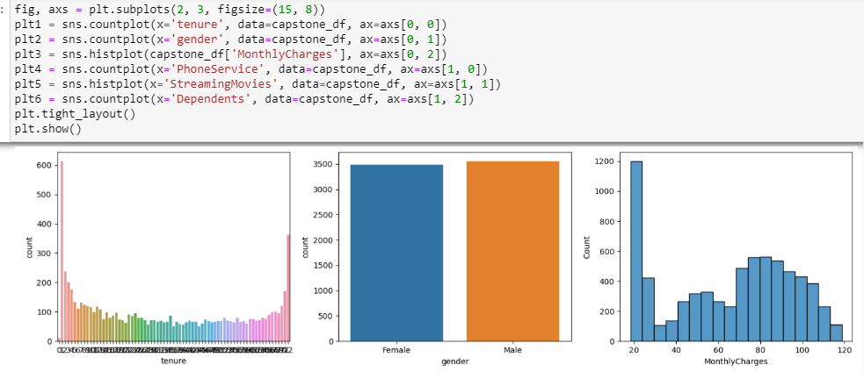
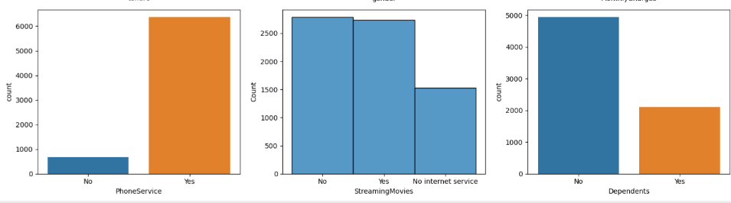
Exploratory data analysis: Univariate Cont.

Slide 8
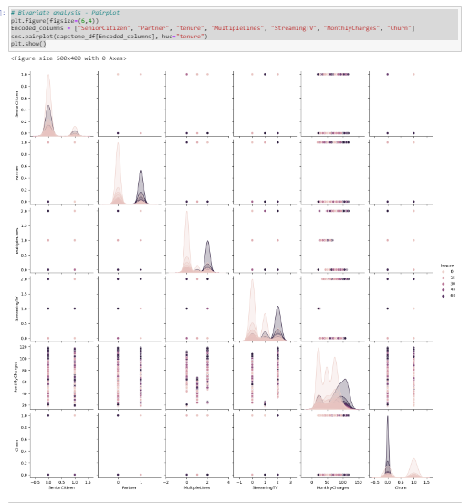
Exploratory data analysis: Bivariate

Slide 9
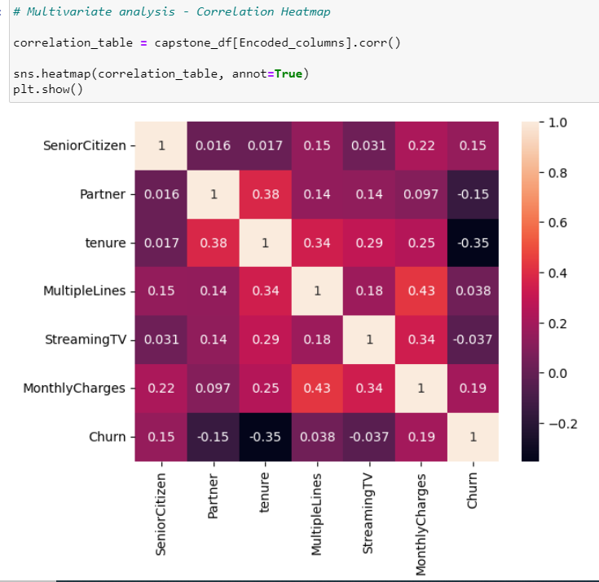
Exploratory data analysis: Multivariate

Slide 10
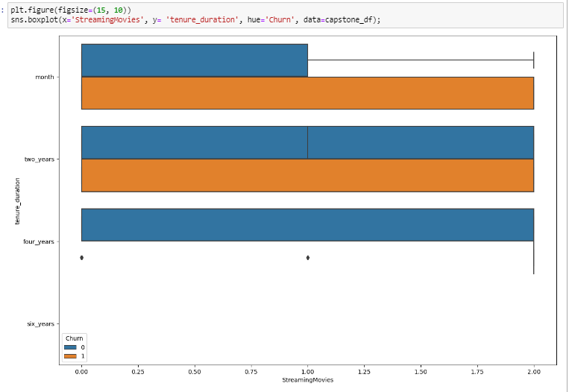

Feature Engineering and Data pre-processing

Slide 11
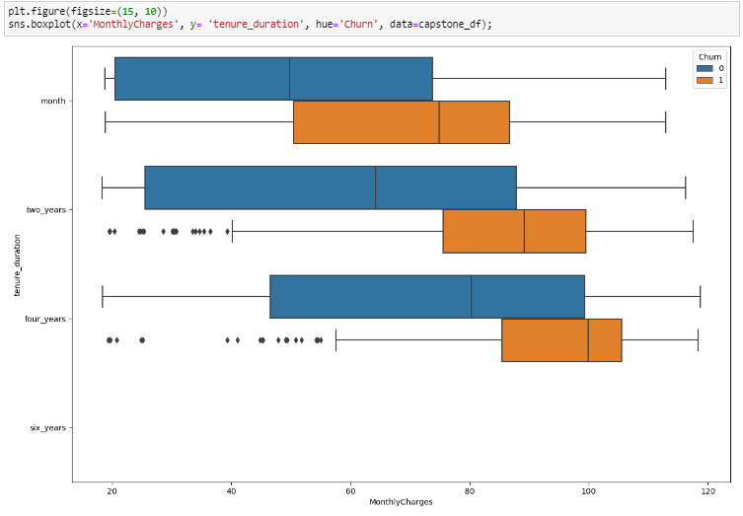
Feature Engineering and Data pre-processing Cont.

Slide 12
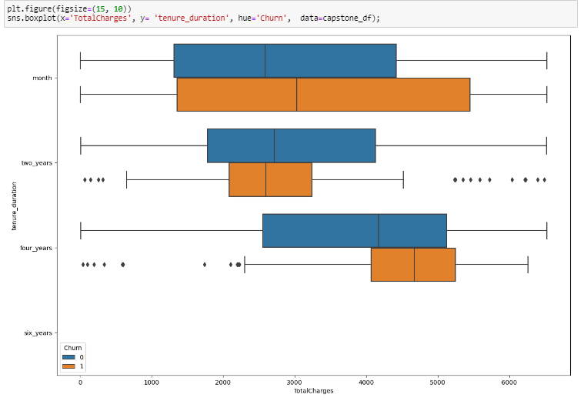
Feature Engineering and Data pre-processing Cont.

Slide 13
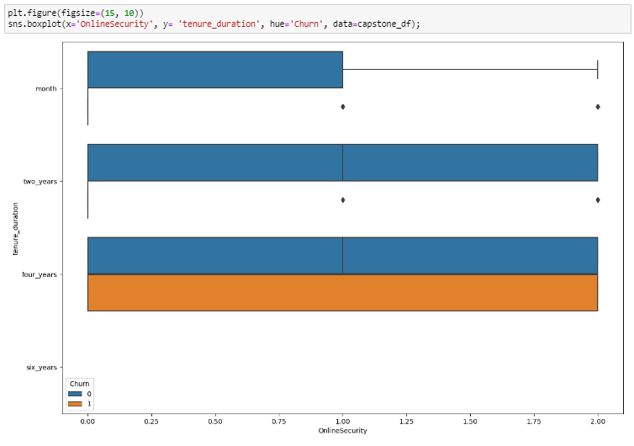
Feature Engineering and Data pre-processing Cont.

Slide 14
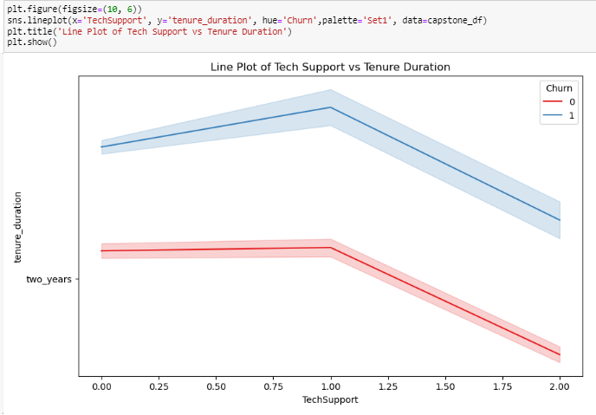
Feature Engineering and Data pre-processing Cont.

Slide 15
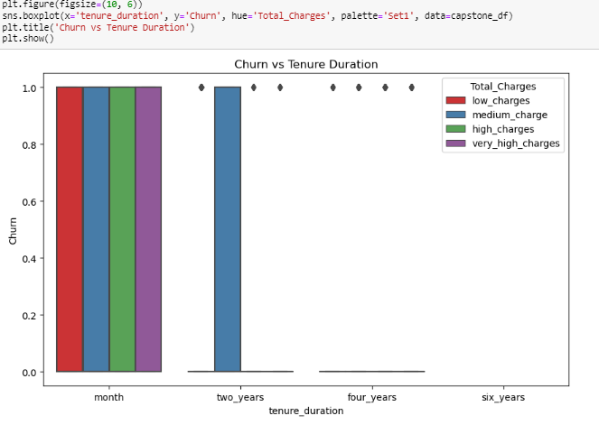

Feature Engineering and Data pre-processing Cont.

Slide 16
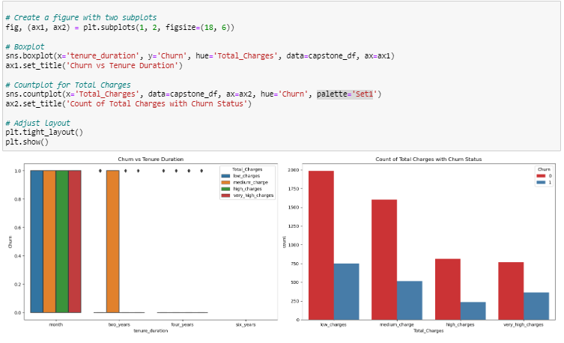
Feature Engineering and Data pre-processing Cont.

Slide 17
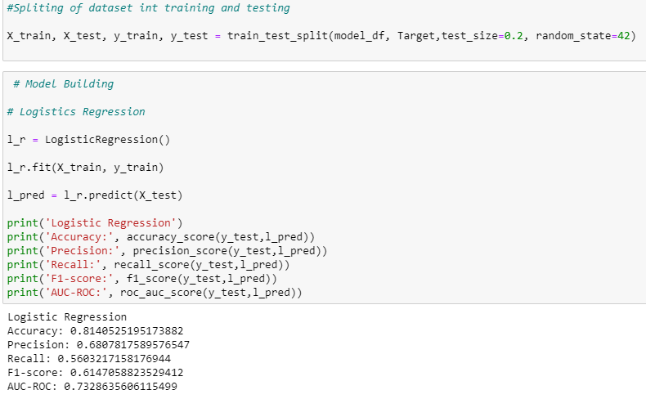
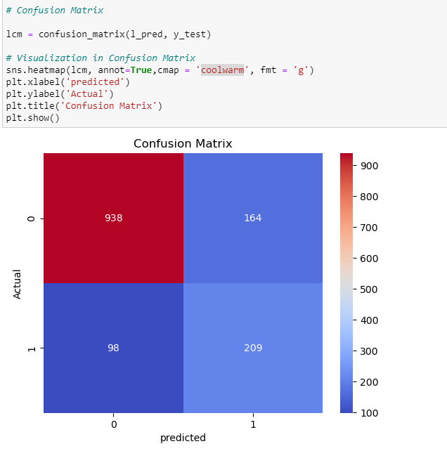
Machine learning

Slide 18
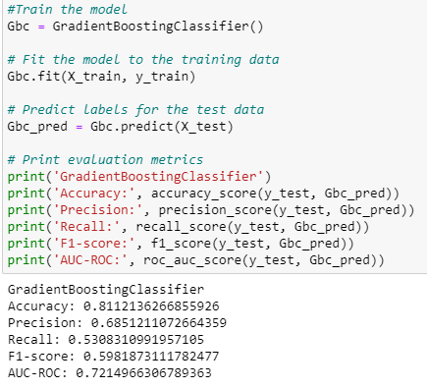
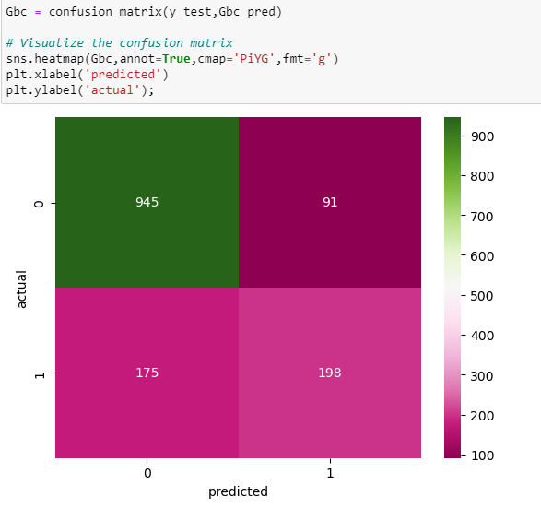
Machine learning

Slide 19
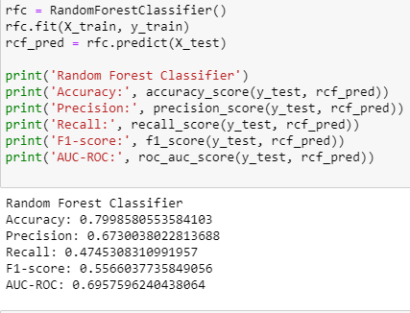
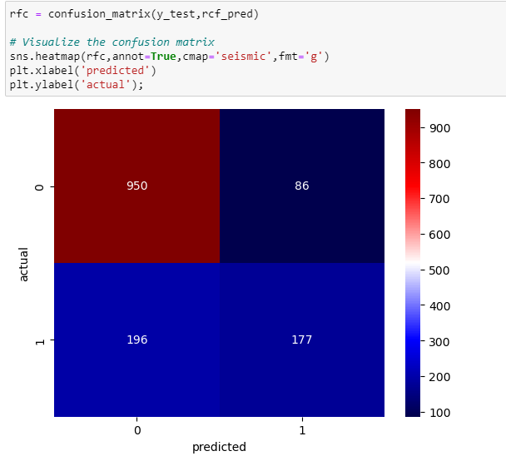
Machine learning

Slide 20
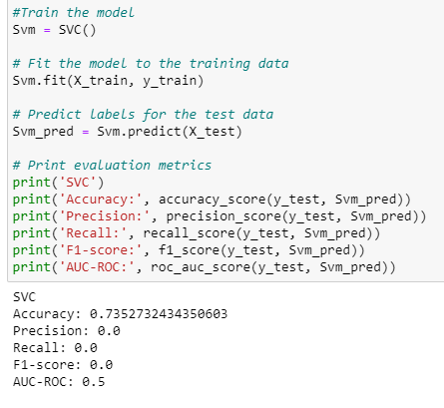
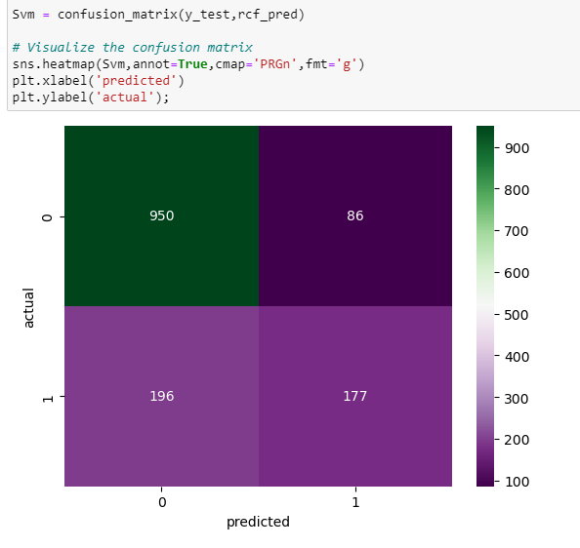
Machine learning

Slide 21
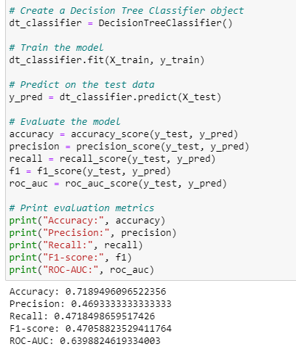
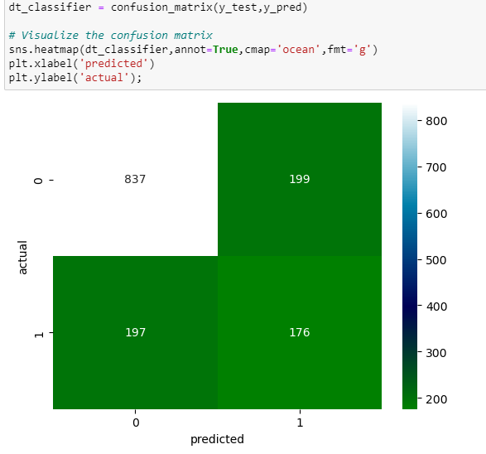
Machine learning

Slide 22
Recommendations

Slide 23
Conclusion

Slide 24
THANK YOU

